Slide 1

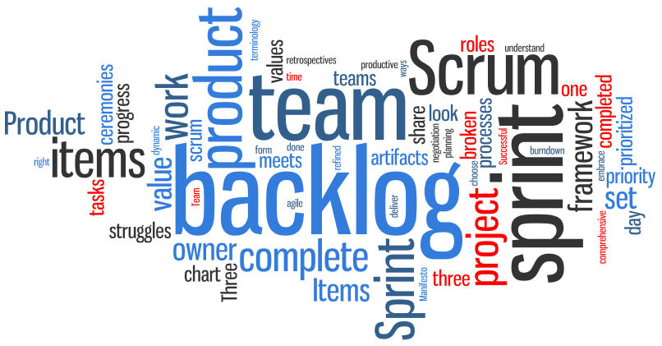
Team 3 Sprint ONE Report
Present by:
Weicheng Yu
Chen Shou
Lu Min
Notes:
‹#›
Hi everyone. We are Team 3. I am Weicheng, backup team leader and security leader of the team. This is Chen Shou, our Requirement Leader and Lu Min, our QA Leader. Just to refresh your memory, we were working on a project management web application called Propal. As you may notice, our logo is displayed on the left upper corner of this slide. It is composed by three lovely dophines and according to our Team Leader, Dawei, these three dophine represent three important roles in scrum, product owner, scrum master and developers.

Slide 2
Overview
Requirement Analysis
Current Architecture
Implementation
Testing
Defect management & Metrics
Process Improvement
Demo
Notes:
1. requirement analysis (user stories implemented in this iteration),
2. current software architecture/design (design patterns, class diagrams, database schema etc)
3. implementation (any special tools, environment used in the implementation, refactor example, framework),
4. testing (any unit testing or system testing examples),
5. process improvement (lesson learned, improvement),
6. quality control and metrics (product metrics, program size, process metrics: person hours etc),
7. defect management and metrics,
8. software demo etc.

Slide 3
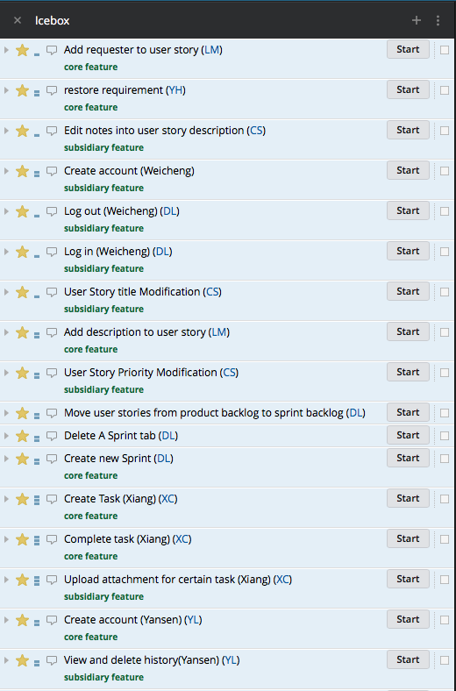
Requirement Analysis
*
‹#›
User Stories implemented in this sprint
Create User Story
Edit User Story
Delete/Finish User Story
Notes:
‹#›
First we are going to talk about requirement analysis. Like many of you, we have tons of new features we would love to implement, but because this is sprint 1, we need to choose the most signifant user stories to implement. These user story must be the heart of our web application, the ones that can best represent our product, because this will be the first prototype for our customer. Due to thoes reasons, we choosed these three user stories from our backlog to implement.

Slide 4
Requirement Analysis
Create User Story
Create basic UIs
UI that take input from user to create a story and display created stories
UI that used to edit a created story
Create Mysql database table to store story information
PHP backend
Ajax - connect to database & query creation
Implement features - edit, create, finish

Slide 5
Current Architecture - Overview
Front-end:
Create basic UIs
Javascript : JQuery
HTML
CSS : Style.css
Back-end:
Create APIs
PHP
Database:
MySQL
phpAdmin
Notes:
Scope of architechture, just for a reminder of our previous iteration design
So it’s html as a basic interface, and using

Slide 6
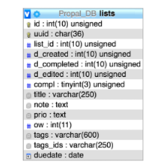

Current Architecture - Database
*
‹#›
Notes:
‹#›

Slide 7
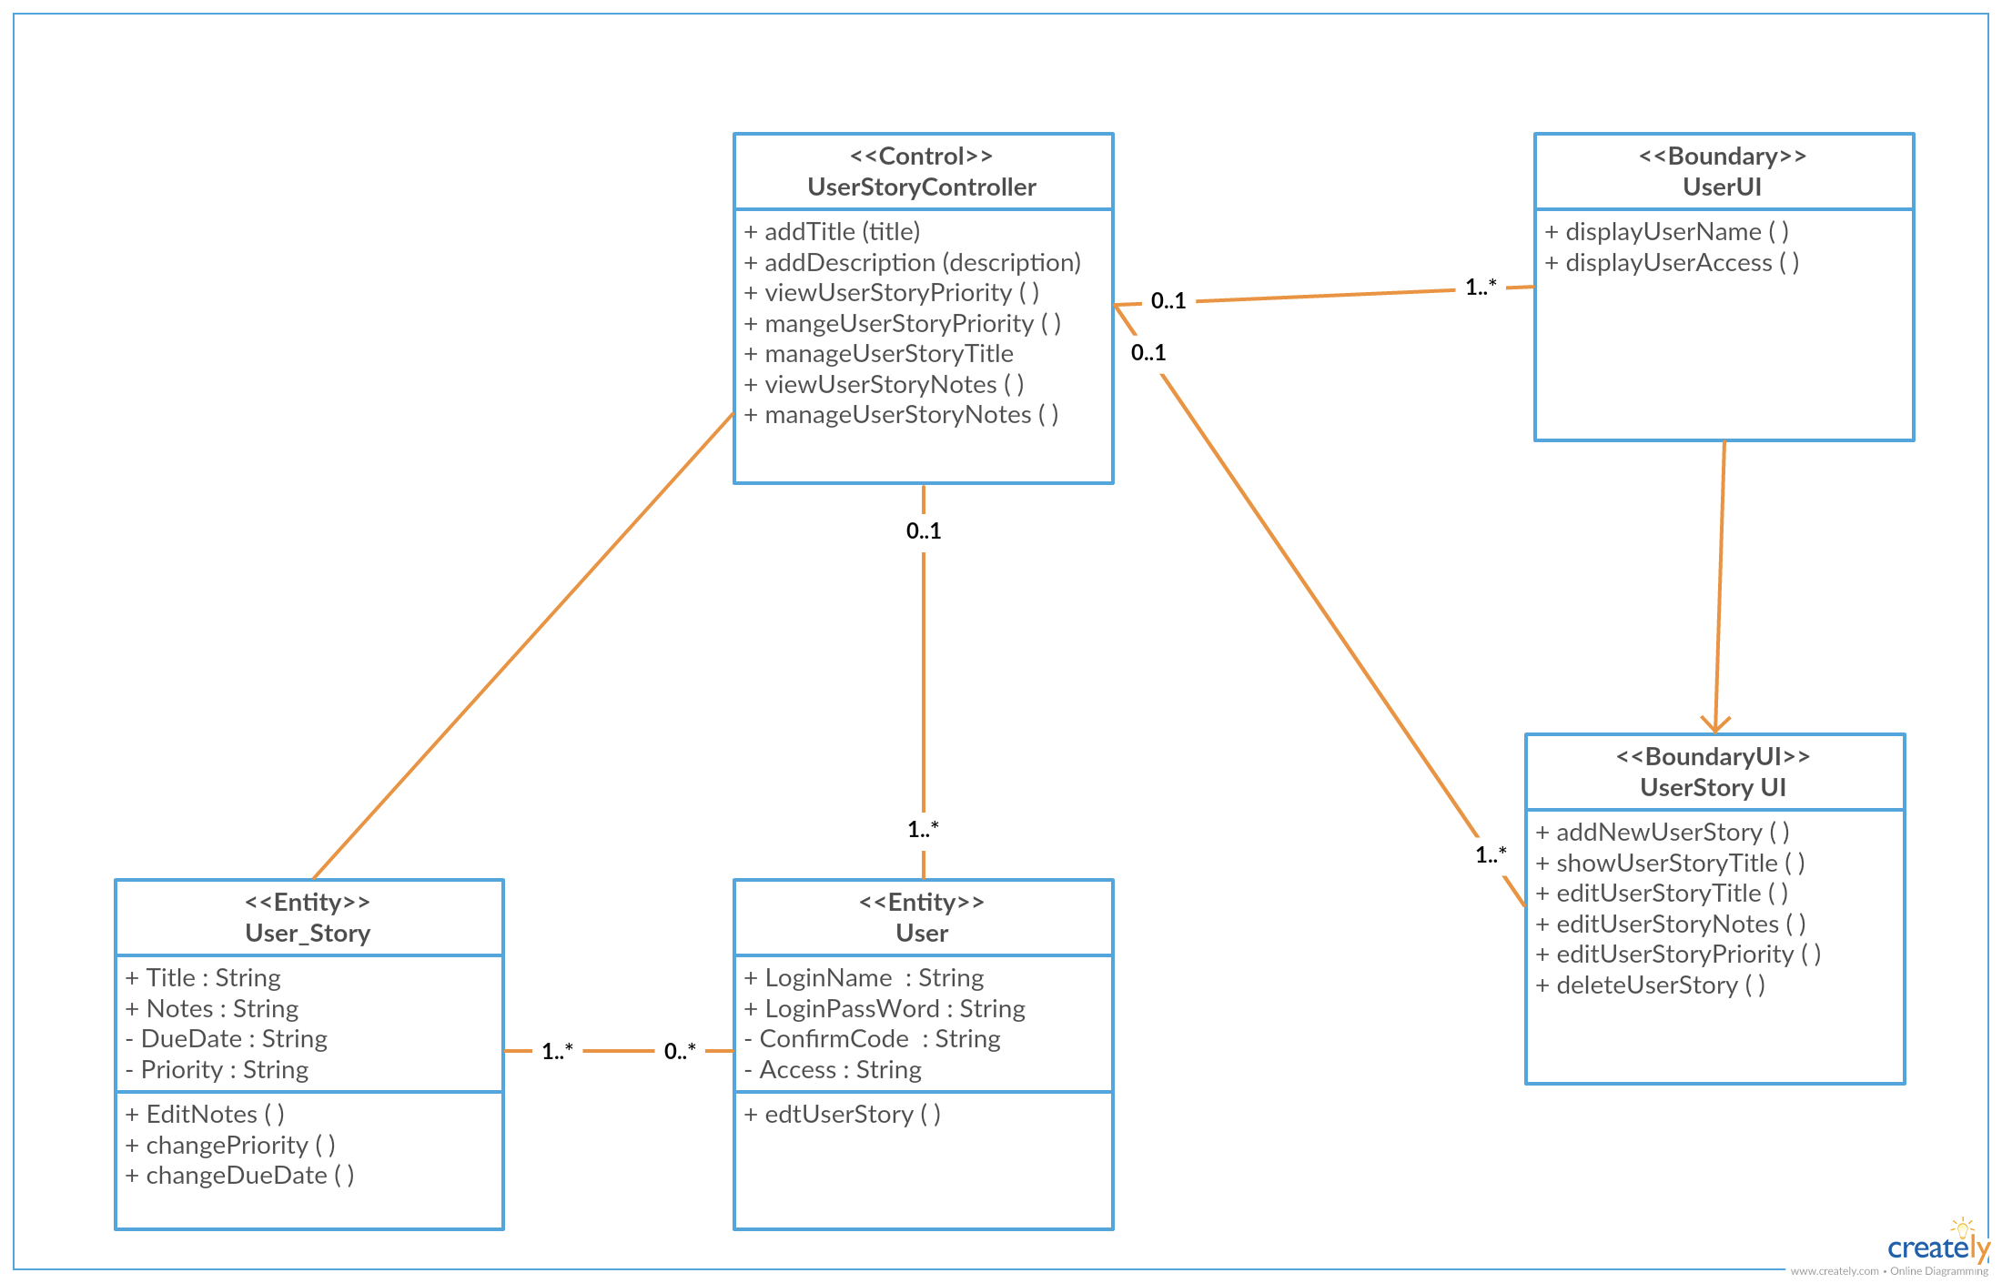
Current Architecture - Class Diagrams
*
‹#›
Class diagrams have a number of benefits for propal development.
Notes:
‹#›
Class diagrams are a type of structure diagram because they describe what must be present in the system being modeled. They are typically used by engineers to document software architecture.

Slide 8


Implementation
Host server: Digital Ocean
Tools:
Database - MySQL, phpAdmin
IDE - Intellij
Editor - Sublime Text3
Local LAMP environment - MAMP
Refactor Example:
Original design:
Create user story by create button
Click to enter title in new page
Enter notes in new blank page
Select priority for new user story
Current implementation
Fastly enter new title to create a new user story
Double click on new story to edit notes, modify title, modify priority instead

Slide 9






Testing
Unit testing
Integration testing
Functional testing
Compatibility testing
Performance testing
Usability testing

Slide 10


Slide 11
Defect Management
Criteria of defect:
Defect severity:
Severity 1 - Critical (S1)
Severity 2 - Major (S2)
Severity 3 - Moderate (S3)
Severity 4 - Low (S4)
Defect priority
Priority 1 – Critical (P1)
Priority 2 – High (P2)
Priority 3 – Medium (P3)
Priority 4 – Low (P4)

Slide 12

Process Improvement
Lesson Learnt
Necessity of code review
Before we include code review, git was messy
After, each commit need to be approved by Implementation Leader
Every member should report any contributions to Slack
Do it as soon as contribution is made
Do not wait until weekly meeting
Notes:
Report updates to members

Slide 13


Slide 14
Questions?

